Slide 1
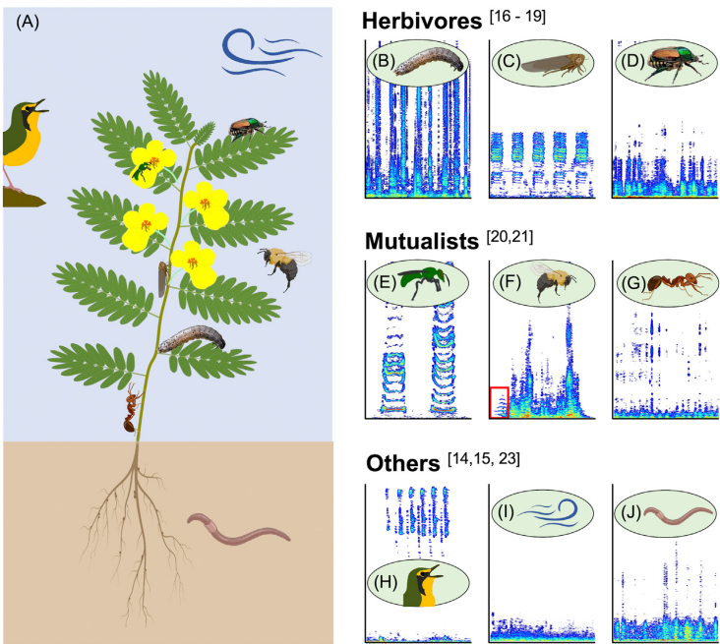
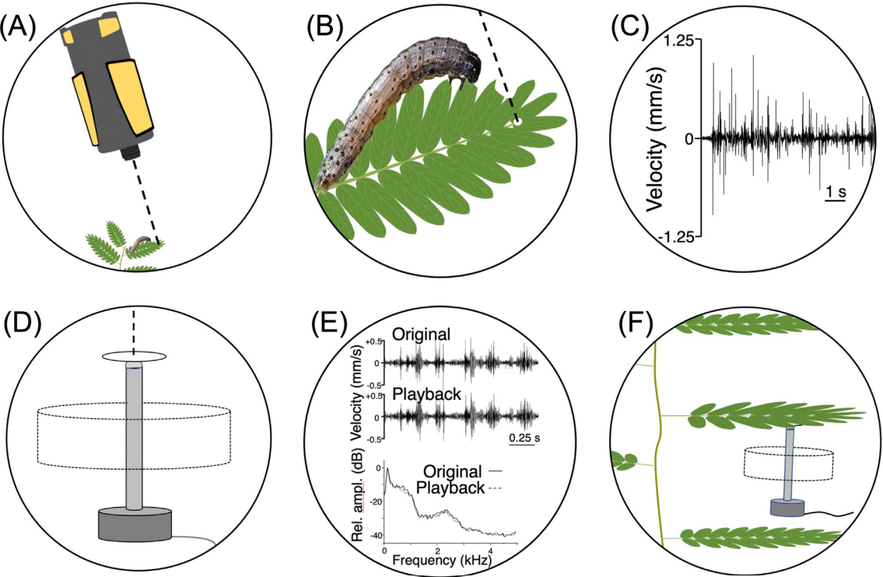
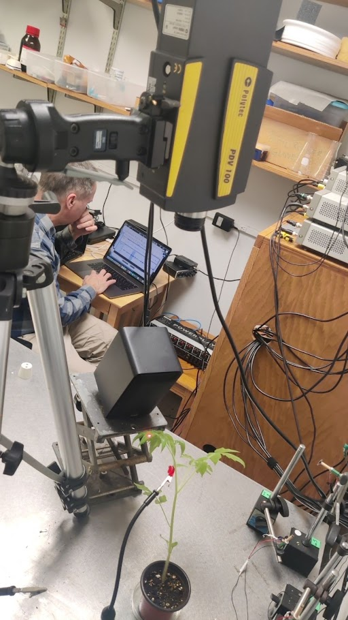
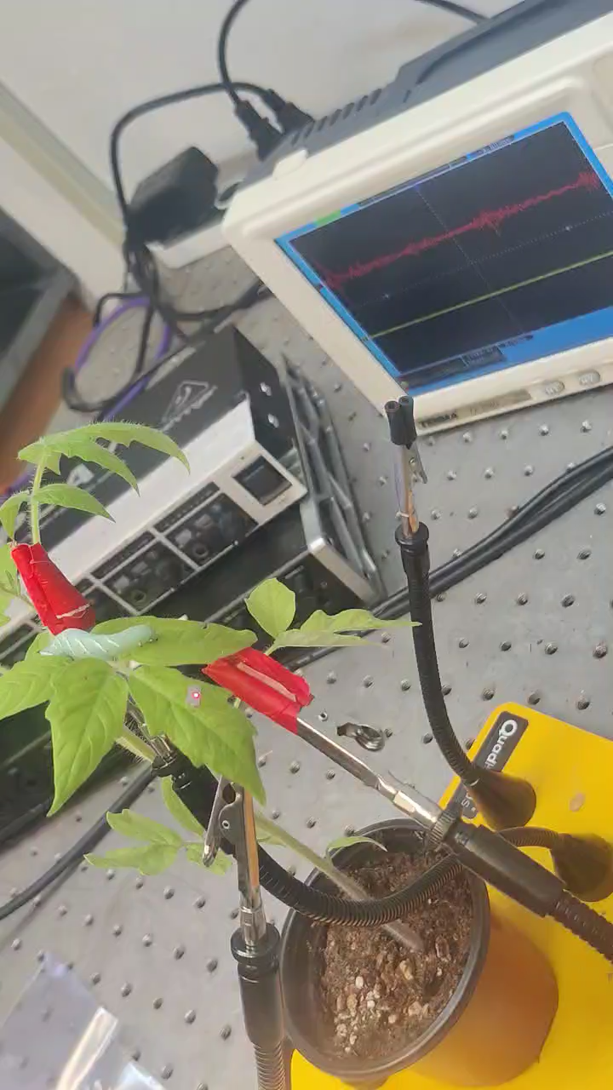
Plant eco-acoustics
Plants perceive and respond to sound and vibration signals
This mechanisms can help develop innovative pest management strategies.
Doppler shifts (play back)
A laser vibrometer
Recording herbivory plant acoustic vibration
Appel & Cocroft, 2014
Vibration actuators
Accurately reproduce feeding vibration on plants
Credit to Prof. Cocroft
Caterpillar feeding vibrations and simulated herbivory can:
Activate hormonal signaling pathways (Body et al. 2019)
Prime glucosinolate and phenolic based leaf defenses (Appel & Cocroft, 2014)
Modulate the release of volatile organic compounds from leaves (Body et al. 2019): repel herbivores, attract natural enemies (predators and parasitoids).
Notes:
Goal is usually to record the vibrations produced during herbivore feeding on a leaf, and recreate those vibrations on an undamaged leaf of a new plant.
thaliana leaves increased their glucosinolate defenses in response to displacements
(C) singing by an unidentified leafhopper;
(D) walking by a Japanese beetle.
(E) Buzz pollination by a halictid bee.
(F) visit to a depleted flower by a common eastern bumblebee

Slide 2

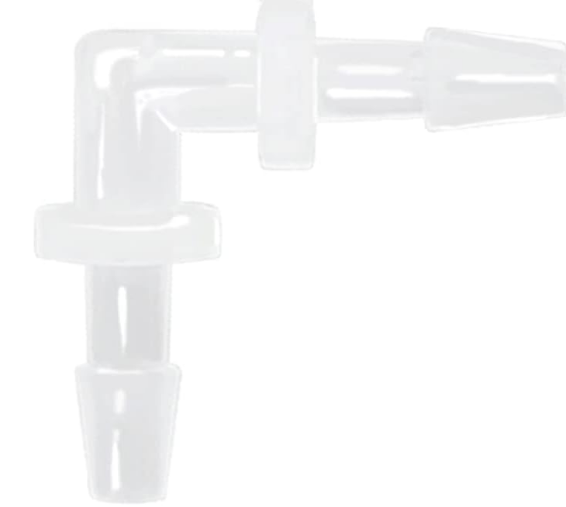

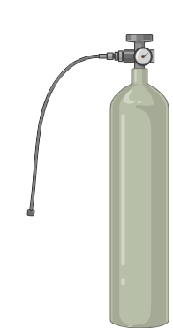
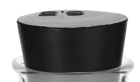
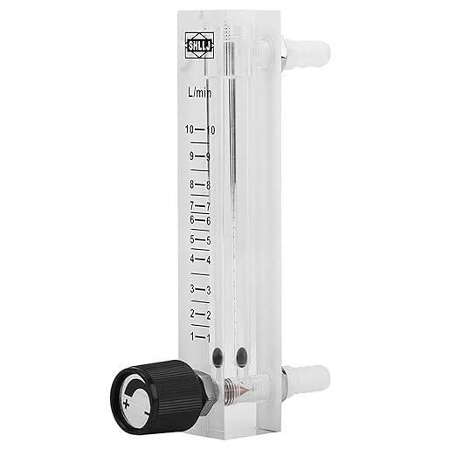

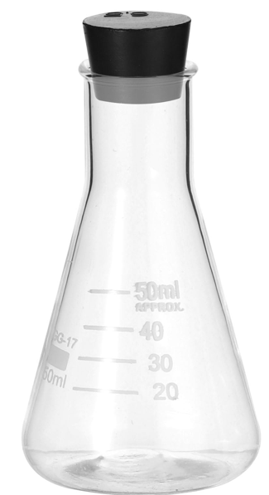
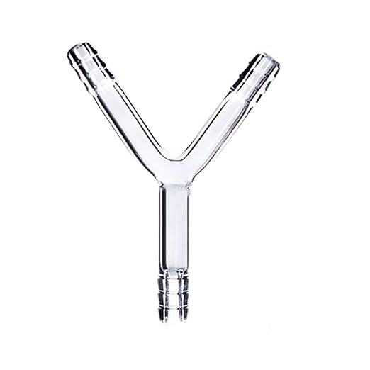








Olfactometer prototype:
Validate plant defense response to simulated vibration signals
Air flow
Air flow
Air flow
Air flow
Flow meter
Air flow
Flow meter
Air flow
Potted tomato plant
Air flow
Air flow
Aluminum foil cover
Oduor source
Not treated
Oduor source
VS-treat
Y Tube olfactometer
Mirid release
Activated Charcoal
Clean air
Natural Gas cylinder
Water
Air Humidifier

Slide 3
Further work and implications
Redesign field experiments to limit competitive effect of commercial pherocon lure.
Compare response across different olfactometers.
Nutritional or diet analysis of ACV+Ayeast.
GCMS/LCMS for difference in attractive volatile odor profiles.
Potential for electro anteno-gram experiments to determine specific volatile/odors to which SWDs respond.
Importance of collaboration and synergy.
Signaling pathways for plant defense response after exposure VS, GCMS/LCMS forVOCs metabolome analysis, potential field application/pilot studies.
Notes:
EAG – Greater potential in Plant eco-acoustic

